Slide 1
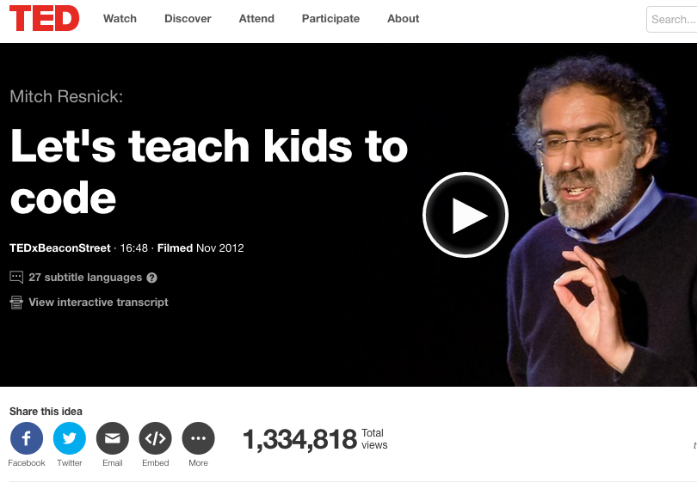
CS education: teaching computer science

Slide 2
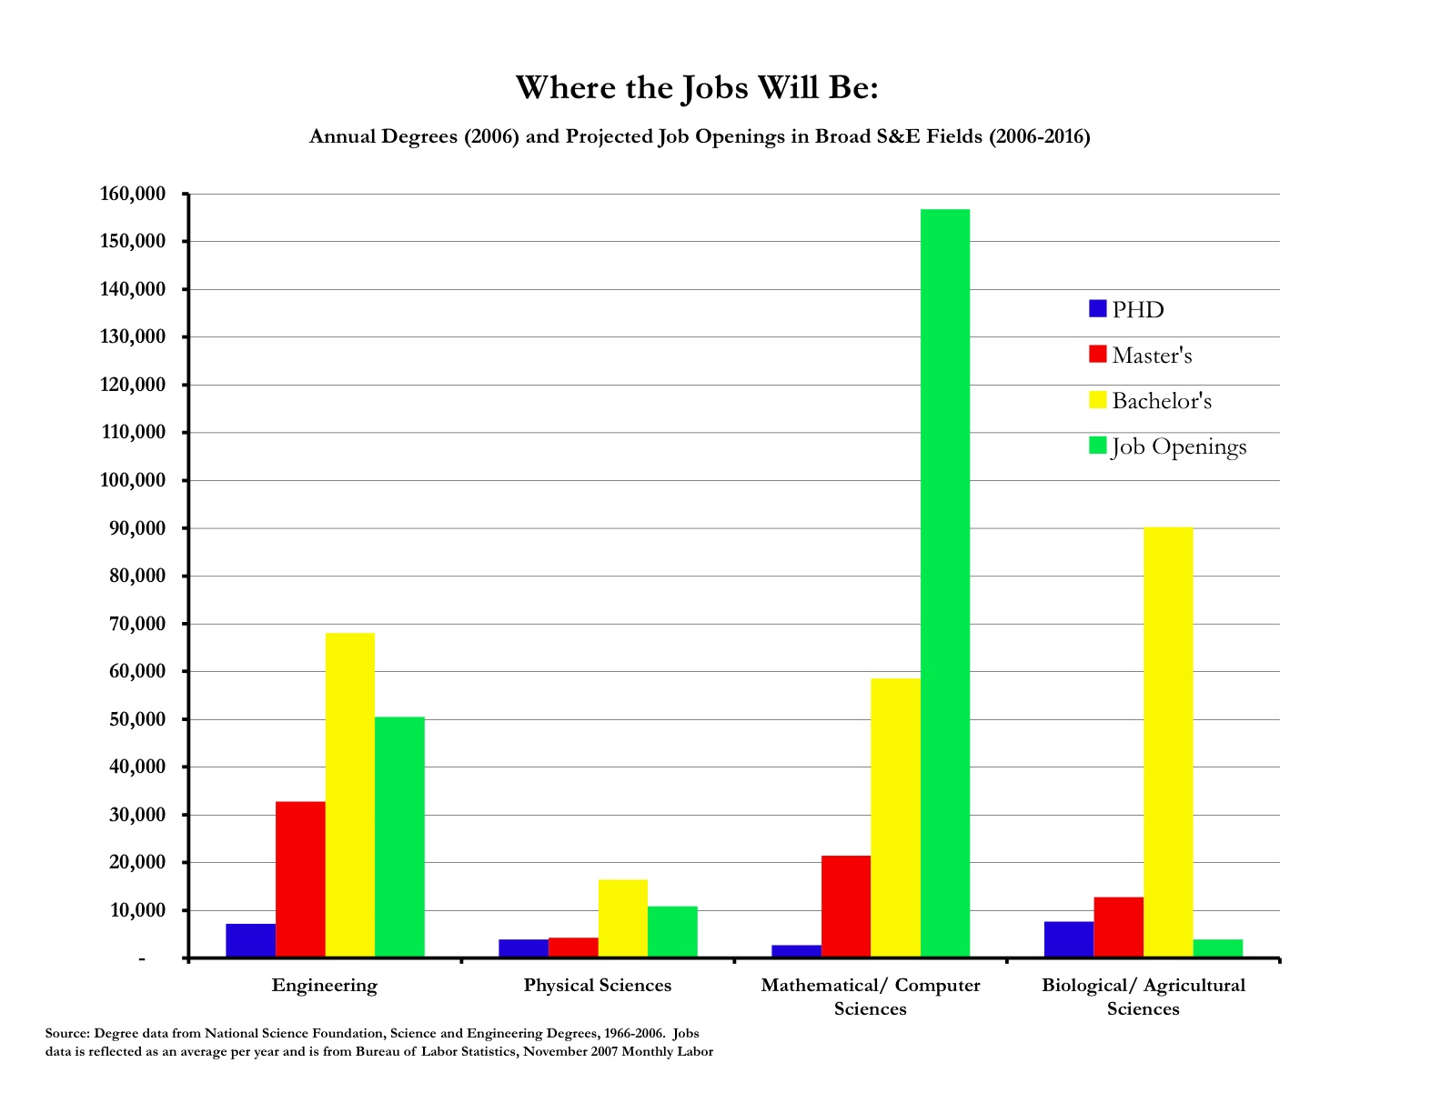
Teaching programming
Teaching computer science has become a huge industry:
Huge job growth
Not enough CS-trained people to fill need

Slide 3
Teaching languages
Not enough CS majors of any type
Combined with lack of diversity and higher drop out rates in CS courses, this is a matter of national concern
President Obama’s state of the union in 2016: "In the coming years, we should build on that progress, by ... offering every student the hands-on computer science and math classes that make them job-ready on Day 1."
As a result, CS education has grown in recent years, with a strong emphasis on how to introduce coding to kids
Alice and Scratch are perhaps the earliest serious efforts into this area, and are still probably the dominant choices
We’ll talk about several alternatives, and see two seriously:
Lego programming (because I love it)
Scratch – the one I know the best

Slide 4
Alice
Designed in mid-90’s by Randy Pausch, a professor at CMU who focused on HCI and design
“Alice is an innovative 3D programming environment that makes it easy to create an animation for telling a story, playing an interactive game, or a video to share on the web. Alice is a freely available teaching tool designed to be a student's first exposure to object-oriented programming. It allows students to learn fundamental programming concepts in the context of creating animated movies and simple video games. In Alice, 3-D objects (e.g., people, animals, and vehicles) populate a virtual world and students create a program to animate the objects.”
--alice.org

Slide 5
Alice details:
Easy to use interface (although does require reading)
Interpreted
Fully object oriented, and focused on causing 3D environment and characters to change
In this case, “objects” are often real things in the scene – people or animals
You can set objects properties (coordinates, opacity, etc.)
There is a library of preprogrammed questions they can ask, like “am I within some distance of another object”
Control flow is written with the usual structures (if, loops, etc), all in a fairly friends drag and drop structure

Slide 6
Alice (cont)

Slide 7
Alice (cont)
Several versions:
3.1 is designed to end with students porting and starting to understand Java by the end of a course
2.3 is a more gentle tool, focused on storytelling
Either has a rich repository of tools and examples, although 2.3 is perhaps a bit better supported
Comes with a pool of 3d objects, but can also design and import your own (using other tools)
Even some support for concurrency

Slide 8
Scratch
Created by Mitchel Resnick and the MIT Media Lab Lifelong Kindergarten Group, released first in 2002
Current version (v2) is Flash based, and runs through a web-browser
Can be used for storytelling as well, but also can be used for other types of programming
Functions are more limited – they are not first class objects
Limited file I/O, but can interface with other systems like Lego Midstorms (which we’ll talk about soon)
Supports 1d arrays, floating point scalars and strings, but limited string functionality
Based on an older language Squeak (which is Smalltalk based)

Slide 9
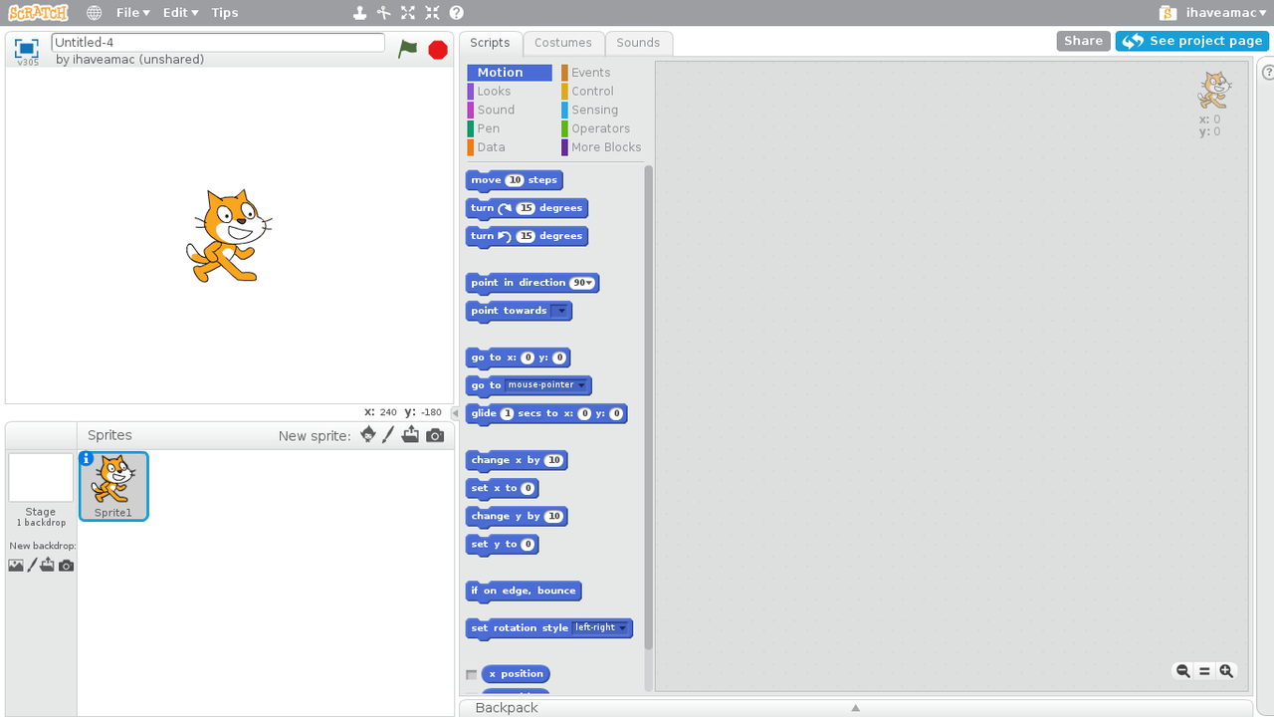
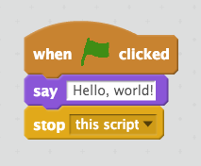
Using Scratch:

Slide 10
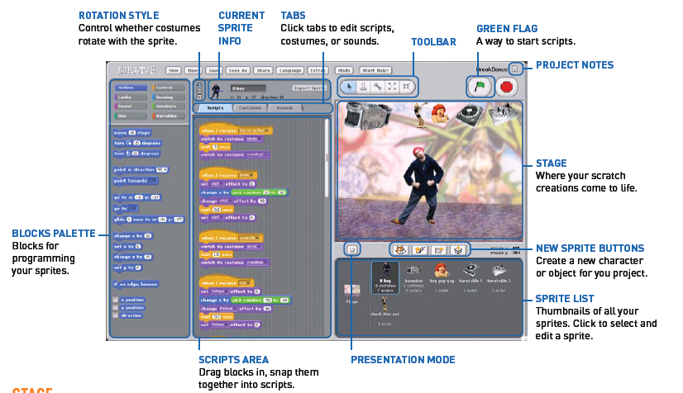
Using Scratch:

Slide 11

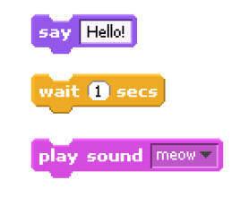
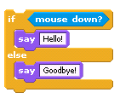
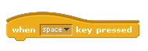
Control flow in Scratch
Statements in Scratch
Booleans and conditionals

Slide 12
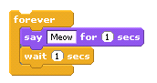
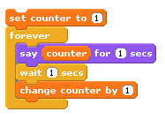
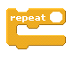
Control flow in Scratch
Loops
Variables

Slide 13
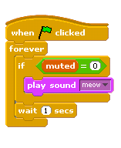
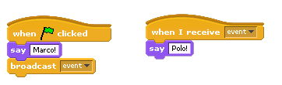
Control flow in Scratch
Events
Threads

Slide 14
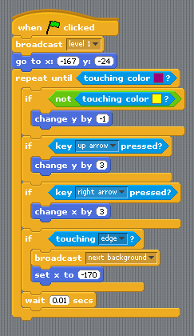
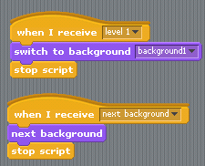
Building things in scratch
In a game (for example), events can be used to change levels.

Slide 15
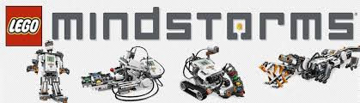
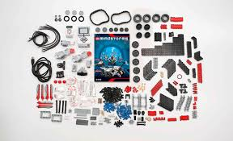
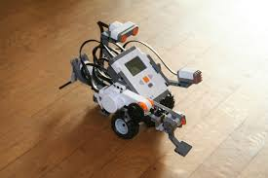
Lego programming
(My personal favorite!)

Slide 16
Lego programming
This language actually goes back to the MIT media lab as well, originally – they developed Brick Logo
Programming is GUI based (at both levels that I’ll discuss), although can interface with C, Java, Python, etc.
Latest versions:
Lego Minstorms EV3, in 2013
Lego WeDo, ~2 years ago
Innovative feature: this takes the “graphical” element to an very high level, especially at the younger kids level
Allows functions (in a sense) as you can form a “myblock” to repeat actions and send in parameters to these

Slide 17
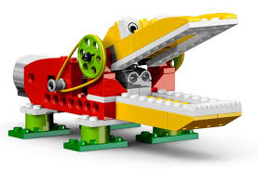
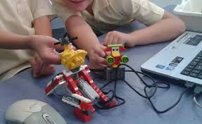
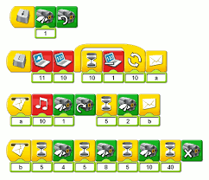
The Lego Wedo

Slide 18
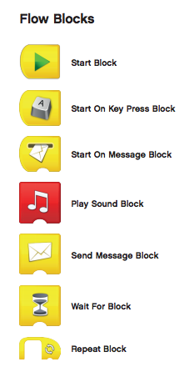
WeDo: details
Basic functionality that you’d expect
Notable feature: no reading is needed!
Start block is required, and from there do basic actions with these

Slide 19
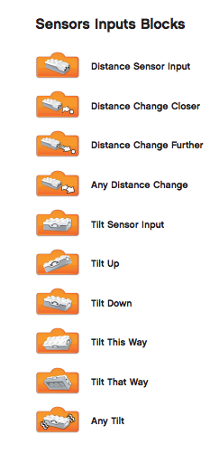
WeDo sensors
The sensor blocks then detect basic events in the model
Usually, you use these to trigger some action, like the bird chirping or the alligator closing its mouth

Slide 20
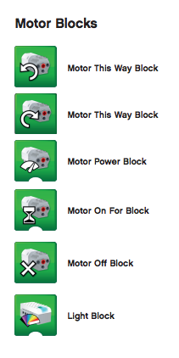
WeDo motor
The motor blocks trigger actual motion in the model
Not required, but usually the most fun
Again, emphasis is on simple design, but very limited functionality is available on these

Slide 21
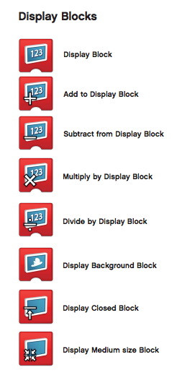
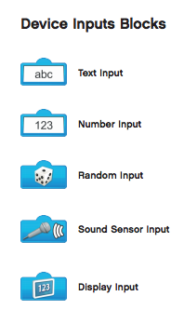
WeDo: other elements
Also blocks to allow input and output

Slide 22
WeDo examples

Slide 23
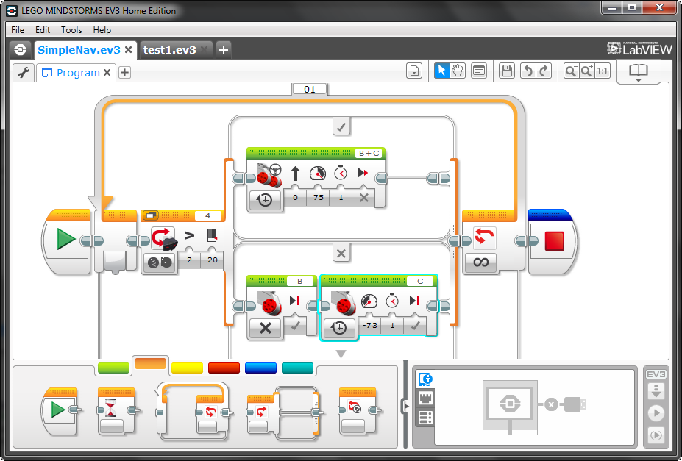
Mindstorms programs
The language:

Slide 24
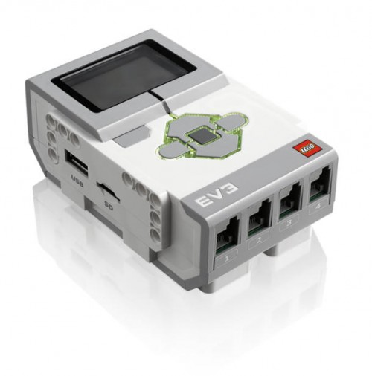
Mindstorms hardware
USB Port for Connection to Computer
Motor Output Ports
LCD Display Screen
Navigation Buttons
USB port for WiFi
Memory Expansion
Sensor Input Ports
Notes:
§ EV3 “brick”
· Have students compare these to human capabilities (brain)
· Controls motors, lights and LCD screen based on instructions and sensory input

Slide 25
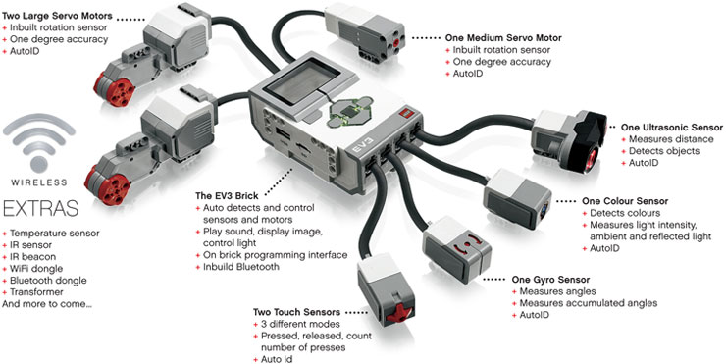
More hardware

Slide 26
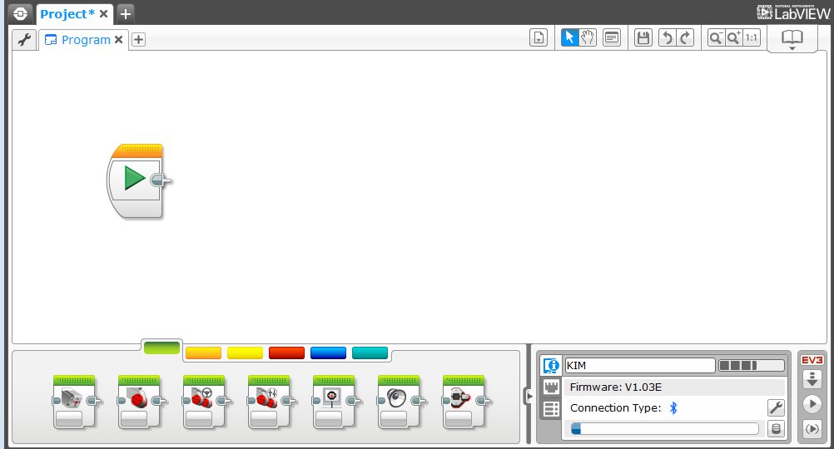
The programming environment
Programming Area or Canvas
Programming Blocks in
6 Colored Tabs
Brick Status & Downloading

Slide 27
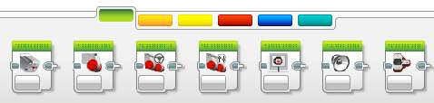
Control blocks
All color coded:
ACTION BLOCKS
Move, Large & Medium Motor, Display…
FLOW BLOCKS
Start, Wait, Loop, Switch, Loop Interrupt
SENSOR BLOCKS
Brick Buttons, Gyro, Color, Ultrasonic
1
2
3
1
2
3
4
5
6
DATA OPERATIONS
Variables, Array, Logic, Math, Compare…
ADVANCED BLOCKS
Data Logging, Unregulated Motor…
MY BLOCKS
Custom Blocks you create
4
5
6

Slide 28
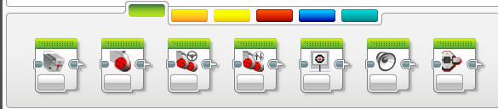
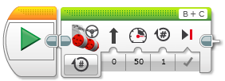
How to program
The GUI interface is very similar to the WeDo one:
STEP 1: Green Block Tab, Click and hold any block and drag to programming area
STEP 2: Drop next to the Start Block (the green arrow, just like the first one)

Slide 29
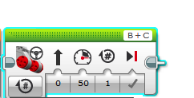
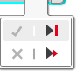
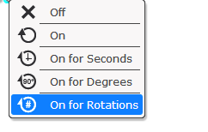
The blocks
Each block has a variety of settings to play with
For example, the move block:
B
C
Mode of operation
Brake/Coast
Steering: Straight or turn
Power/Speed
Duration/Distance

Slide 30

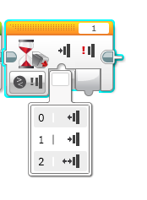

Simple programs:
Program your robot to move straight until you tap the sensor with your hand.
B
0 = released
1 = pressed
2 = bumped
C
Hint: You will combine: Move Steering + Wait Block

Slide 31
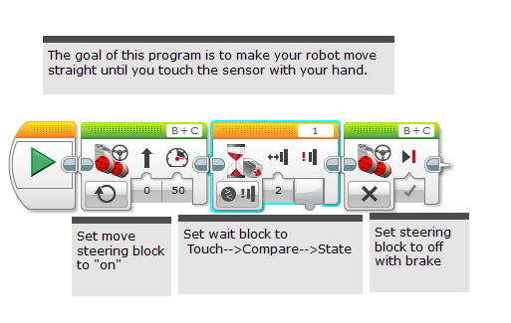
Solution:

Slide 32
Another:
Program your robot to move until it hits the edge of a wall. Then back up and turn right 90 degrees.
0 = released
1 = pressed
2 = bumped
B
C
Hint: You will combine Move Steering + Turning + Wait Block

Slide 33
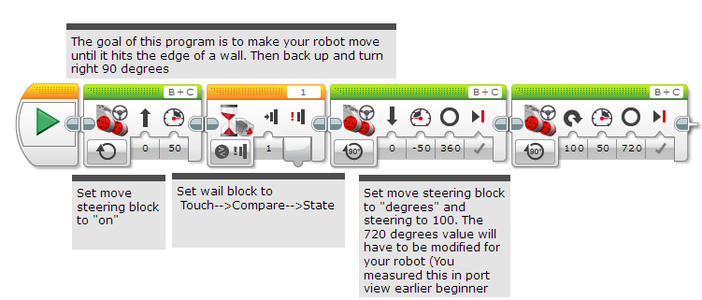
Solution:

Slide 34
Lego robots in action
Minstorms:
https://www.youtube.com/watch?v=dJSeMeAGmXE
Wedo:
https://www.youtube.com/watch?v=w03n-Y18-9I

Slide 35
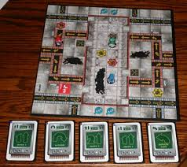
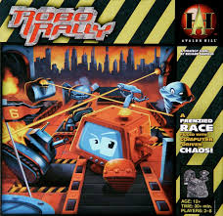
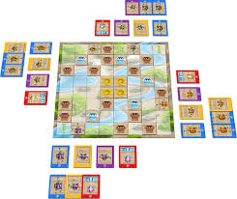
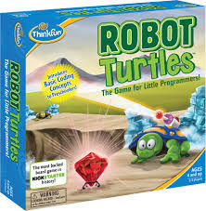
Newer additions: games
The board game Robo Rally:
Or Robot Turtles:

Slide 36
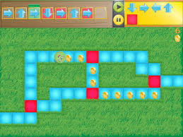
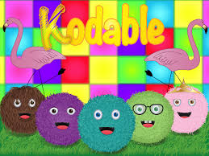
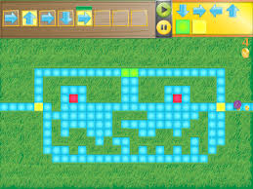
Tablet games
Example: Kodable

Slide 37
Droid inventor
Many new (semi-reasonable) robot inventor kits:

Slide 38
Takeaway and more resources
Educational languages are an interesting mix of psychology and computing
Technical specifications are important
But (generally harder) need to make these so that kids are excited about it!
In any CS major, the CS1 (CSCI 1300 here) course is one of the big blocks – students need the technical content, but we often lose very capable students in that course
The goal of these languages is to lower that barrier and get students to commit to the major before they hit the course
Increasing attention means there is a lot of support – I’d recommend code.org and similar websites.

